Slide 1
Network Segmentation

Slide 2
Segmentation
Main Purpose: Enables ZTNA across multi-region and multicloud, including on-premises environment
Group VNets/VPCs/VCNs/Apps with similar security policies
Define your own domains
Use Cases
Compliance
Governance
Audits

Slide 3

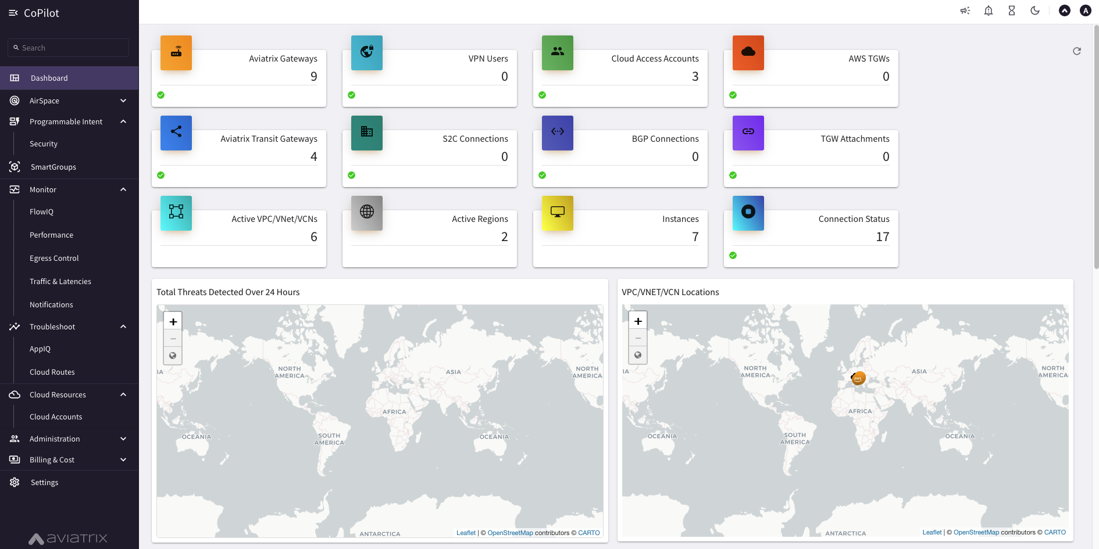
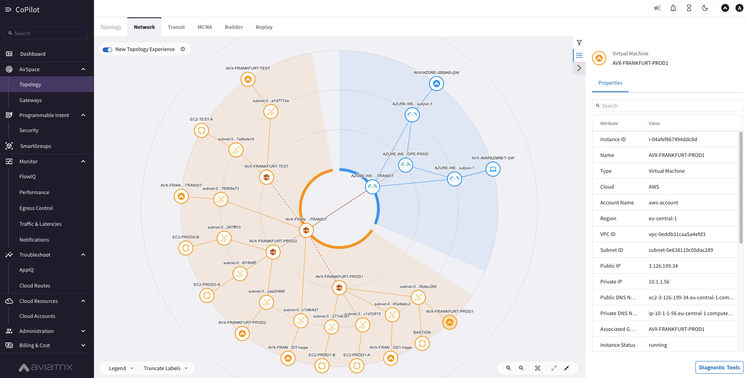
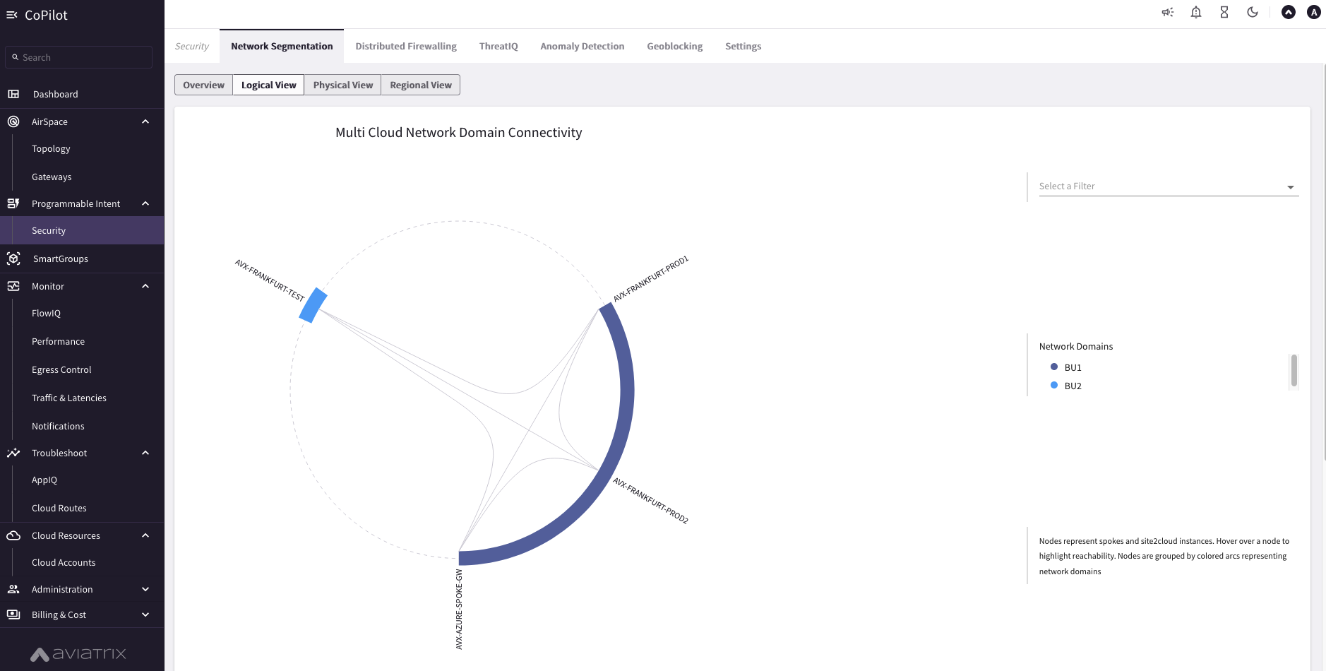
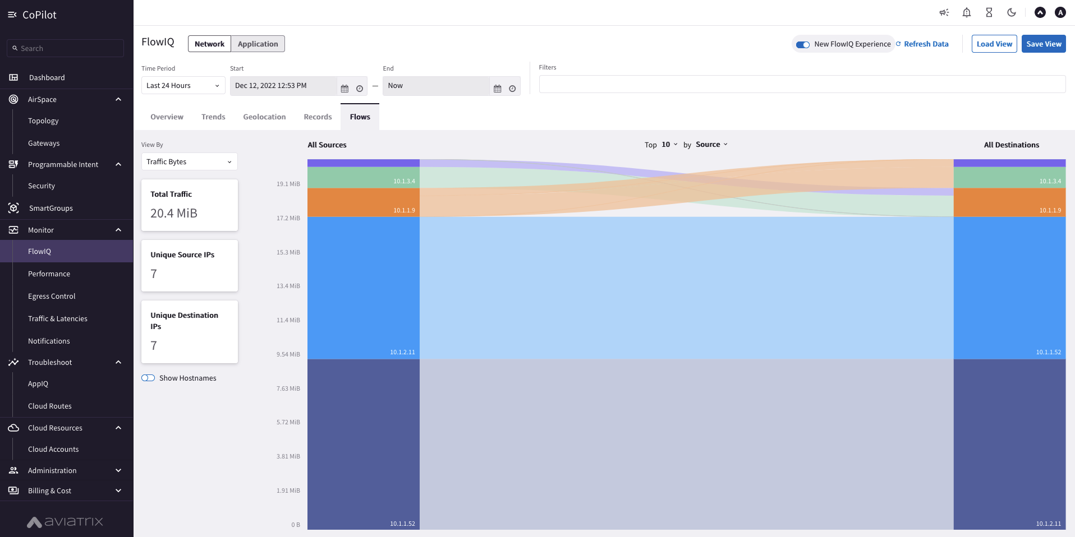



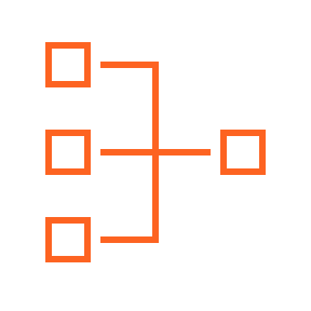


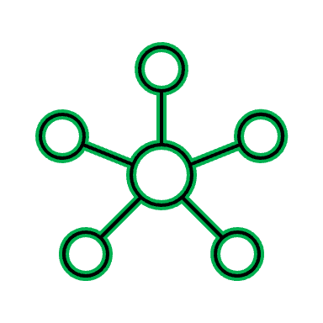

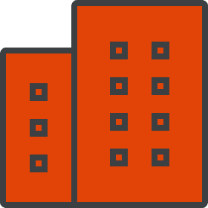
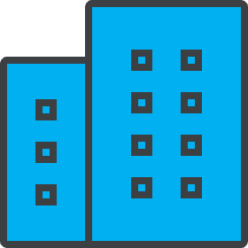
Multicloud Network Segmentation
Aviatrix
CoPilot
Network Granularity and Control
VPC
VPC
VPC
VPC
VNet
VNet
VPC
VPC
VCN
VCN
Region 1
Region 2
Network Domains
Private Interconnect
LOB1
LOB2
LOB3

Slide 4




Multicloud Network Segmentation
Aviatrix
CoPilot
Policy Based Network Segmentation
Global
Consistent / Repeatable
Across accounts, subscriptions & projects
Cloud and Connection Agnostic
Single cloud
Intra-region or inter-region
Multiple clouds
Edge/Access Segmentation
On-Prem DCs
Branches
Extranets
Cloud Peering
On-Demand Compliance/Governance
Security Posture within minutes
Aviatrix control plane realizes the intent
Zero-Trust
Flexible
Automated
Blue Segment
Green Segment
Connection Policy
VPC
SS
VPC
VPC
VPC
VPC
VPC
VPC
VPC
VPC
VNet
VNet
VNet
Transit
VPC
FireNet
Transit
VPC
Transit
VPC
FireNet
Transit
VPC
Transit
VNet
FireNet
IT
BU1
BU2
IT
AWS - REGION1
GCP – REGION1
GCP – REGION2
AZURE - REGION1
DirectConnect
Site2Cloud
Site2Cloud
Express Route
Extranet
Extranet
BRANCH OFFICES
Data Center
Data Center

Slide 5


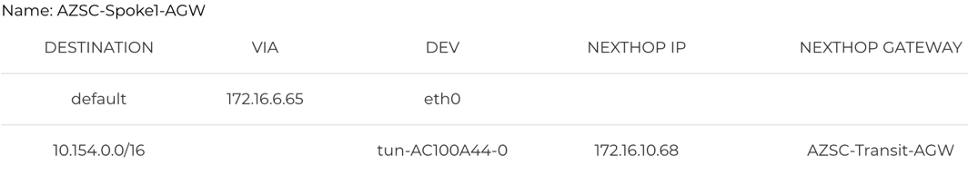

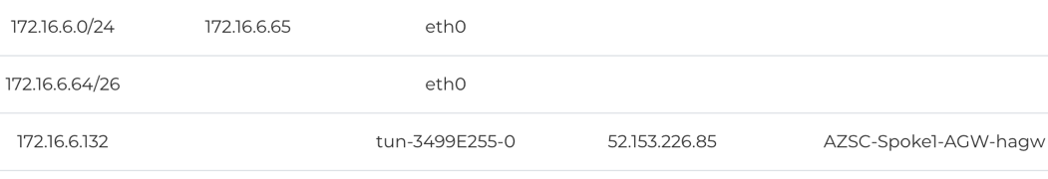

Multicloud Network Segmentation
OR-Spoke-1
OR-Spoke-3
OR-SS
AZSC-Spoke-1
AZSC-Spoke-2
10.150.89.134
10.152.24.64
10.154.90.201
172.16.6.20
172.16.7.20
OR-Transit
AZSC-Transit
65013
65020
Purple
10.160.0.0/16
172.16.10.0/23
Remote-Blue
Yellow
Local-Blue
64701
DATA CENTER
10.200.0.0/16
65050
Partner-1
10.201.0.0/16
Partner-2
10.202.0.0/16

Slide 6
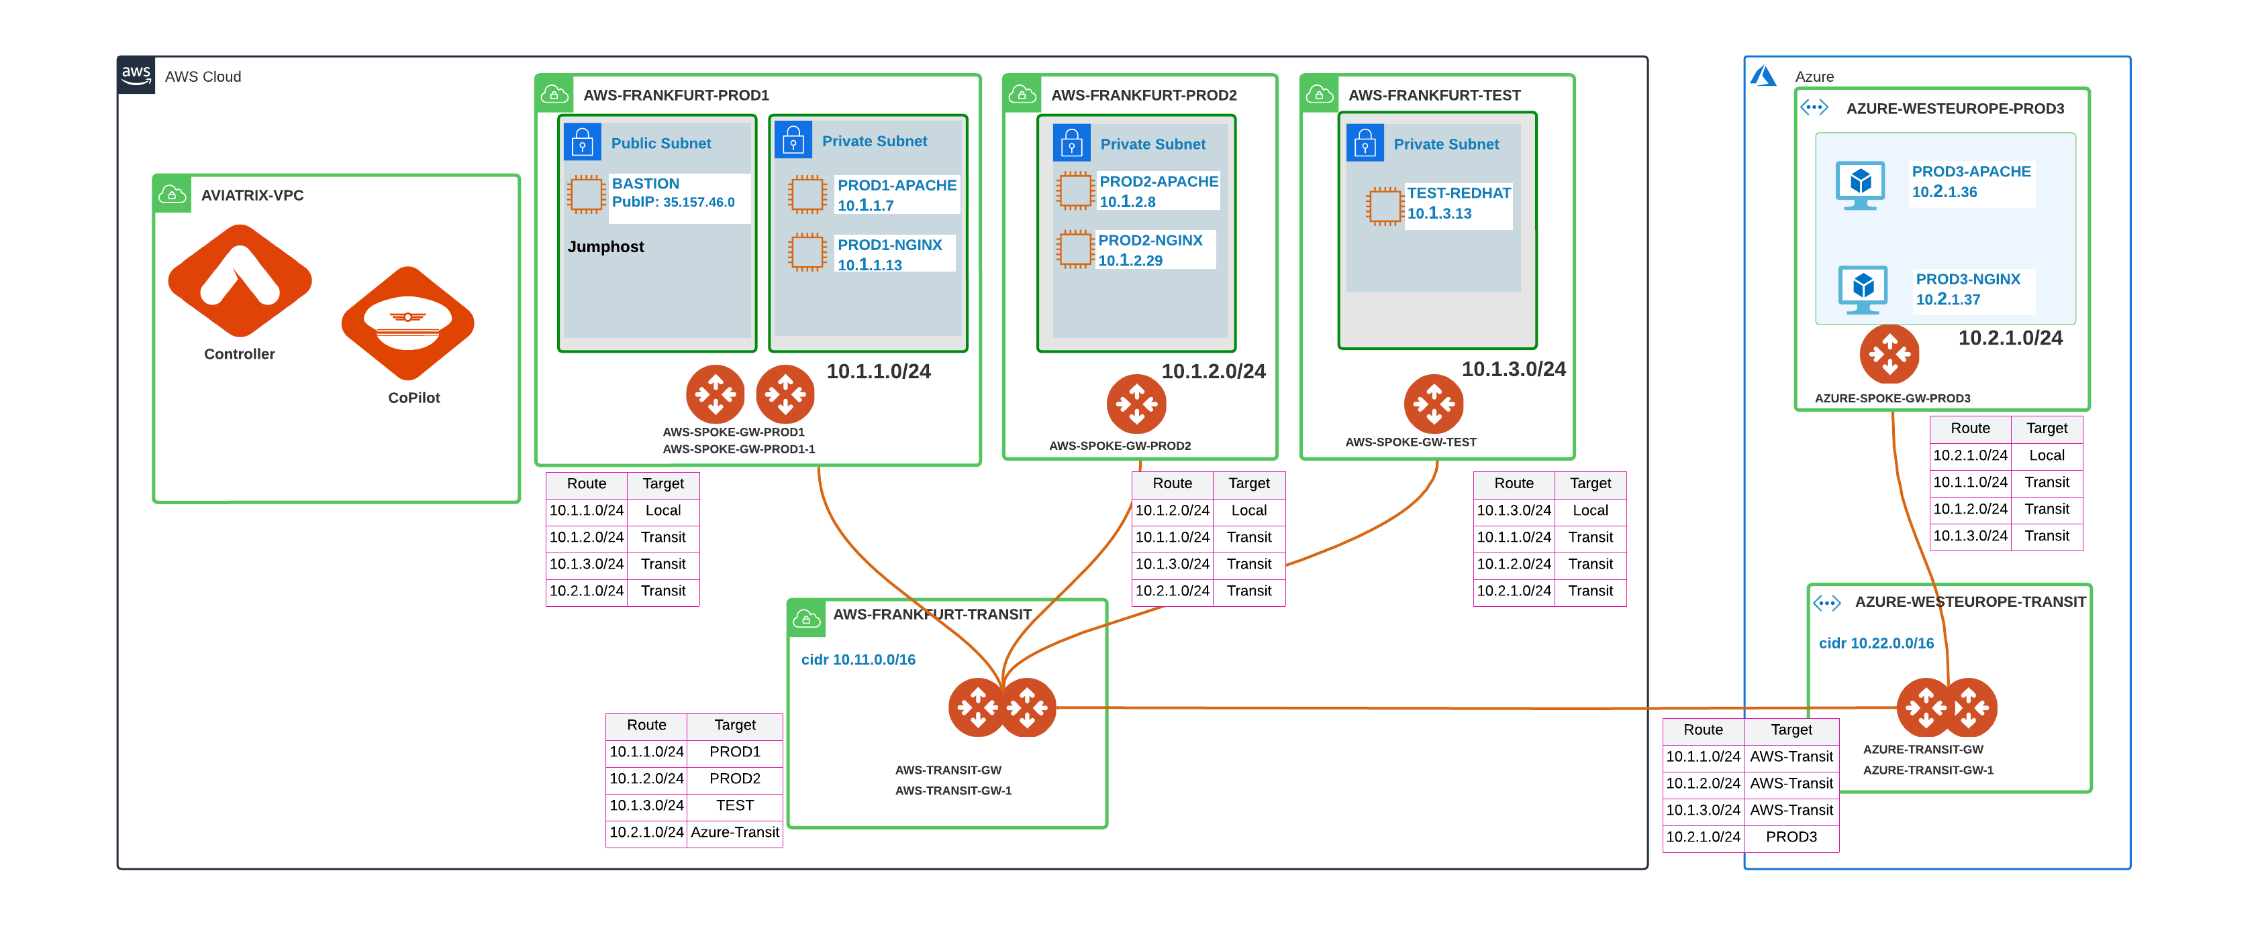
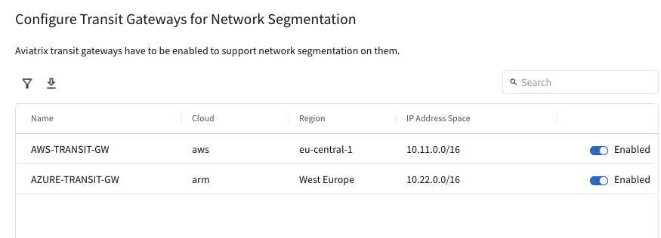
1. Enable Transit Gateways for Network Segmentation
Enable the Network Segmentation:
Choose the Transit Gateway(s) that will route traffic for its members.

Slide 7
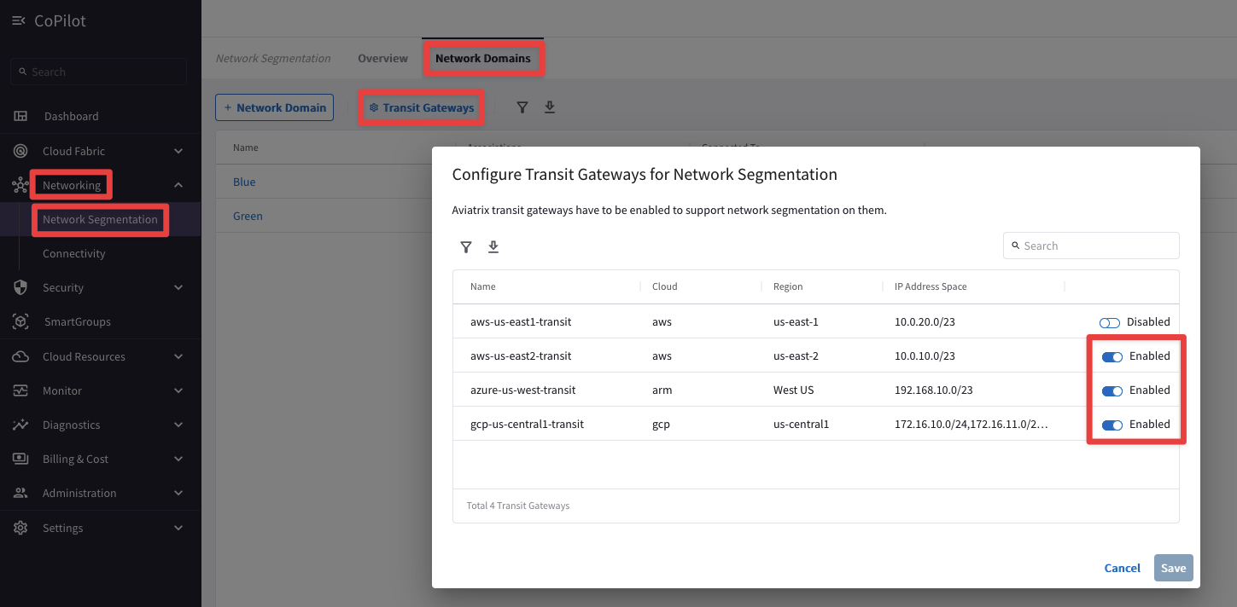
Configuration – CoPilot
Enable Transit Gateway for Segmentation

Slide 8
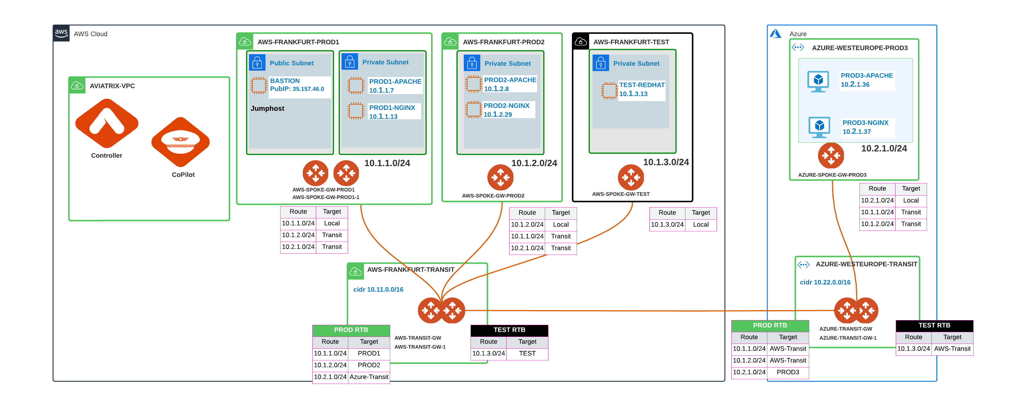
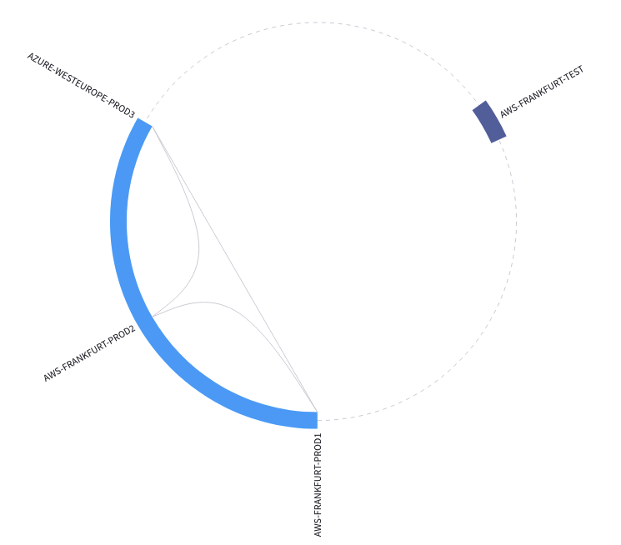
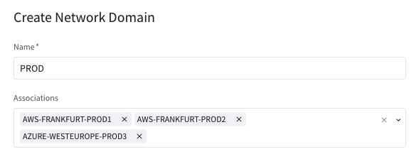
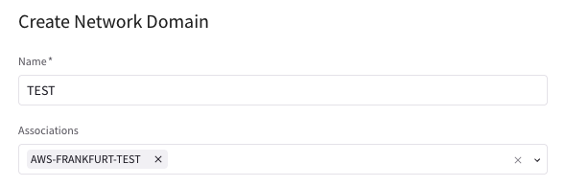
2. Create and Associate a Network Domain
Transit Gateway
Multiple RTBs (per each Network Domain)
Main RTB:
The main RTB will host the Transit Routes (i.e. the routes of the backbone layer) and the routes that belong to Unmanaged Network Domains (i.e. VPCs/Vnets not assigned to any Network Domains yet).
Spoke Gateway
Single RTB (Main)
Create the Network Domains:
Assign a Name to each Network Domain
Associate the Spoke VPCs/Vnets and/or Site2Cloud Connections to the Network Domain
CAVEAT: A network-domain name can only have letters, digits, a hyphen (-), and an underscore (_). The name must start with a letter and must have 2-27 characters. For example, Dev_Domain.

Slide 9
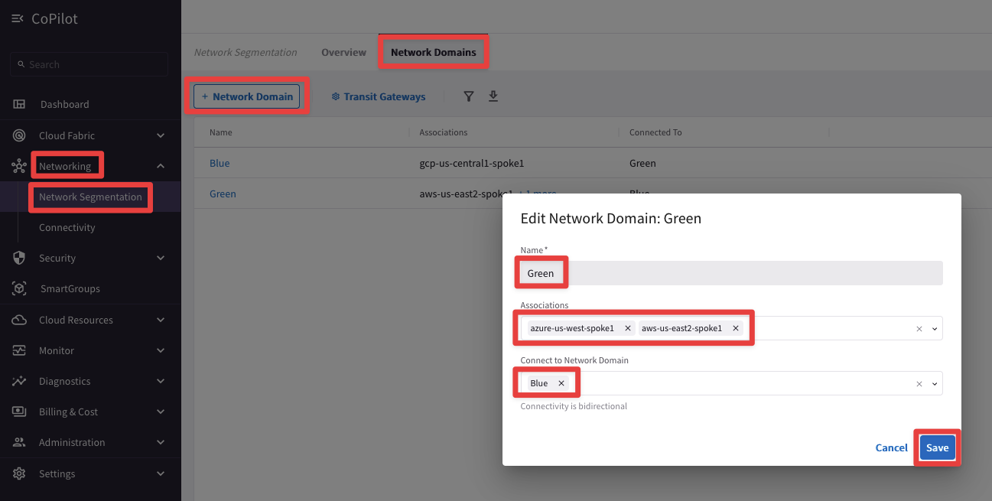
Configuration – CoPilot
Create Network Domains
Associate Spoke Gateways or Site2Cloud connections to Segments
(Optional) Create Connection Policy

Slide 10
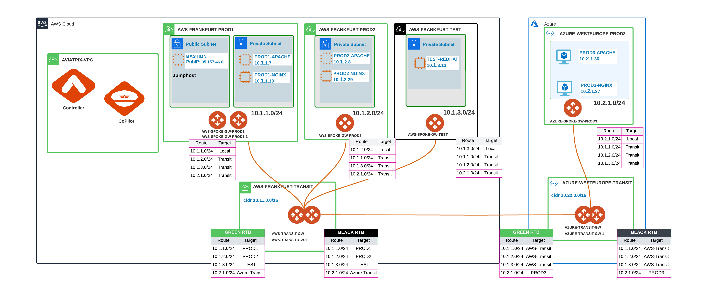
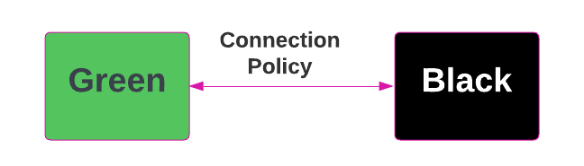
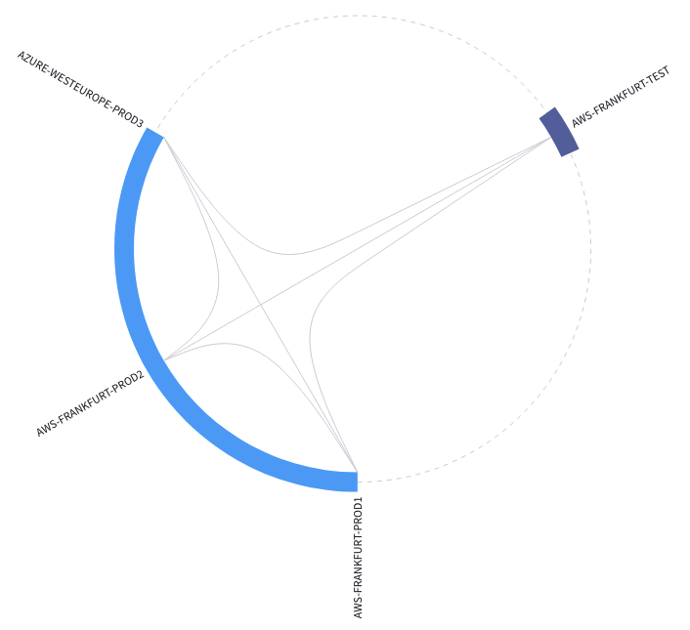
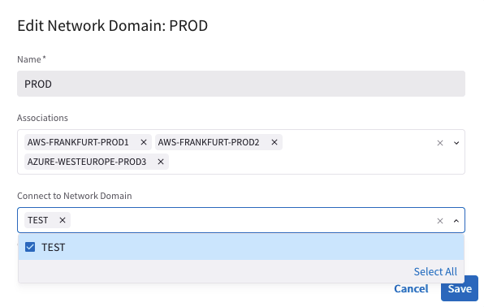
3. Apply the Connection Policy (optional)
Optionally, enable the Connection Policy:
Network Domains’ routing tables are merged (i.e. vrf leaking).

Slide 11
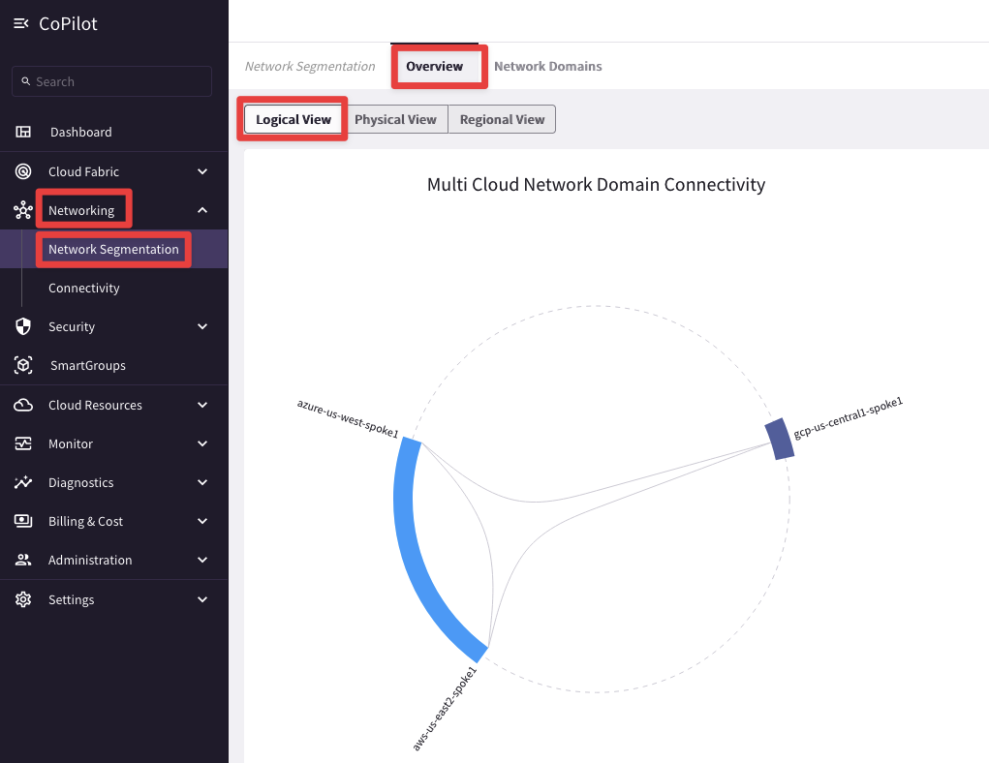
Visibility – CoPilot

Slide 12
Next: Lab 3 - Network Segmentation

